Slide 1

Artificial Intelligence Assignment
Heuristic Search Methods for One Player Solitaire Games :
Cohesion
Jorge Vieira up202204385

Slide 2

Index
Introduction
Problem formulation
Uninformed search
Informed search
Evaluation of results
Conclusion

Slide 3

Introduction
Cohesion:
Solitaire puzzle game
4x4 board
Pieces of different colours
Pieces ‘glue’ together when they become adjacent to each other
Use of search algorithms to solve the puzzles

Slide 4
Problem formulation

Slide 5
Problem Formulation
State representation
Initial state
Objective test
Operators
Solution cost
(Puzzle solvability)

Slide 6
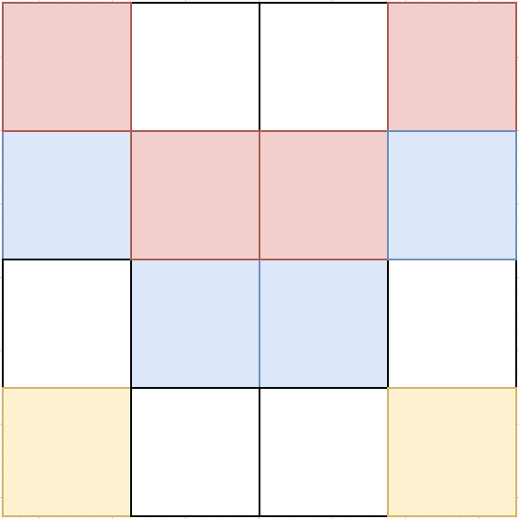
State representation
{"blank" : [(1,0),(2,0),(0,2),(3,2),(1,3),(2,3)],
"red" : {
1 : [(0,0)],
2 : [(3,0)],
3 : [(1,1),(2,1)]
},
"blue" : {
1 : [(0,1)],
2 : [(3,1)],
3 : [(1,2),(2,2)]
},
"yellow" : {
1 : [(0,3)],
2 : [(3,3)]
},
"size" :
(4,4)
}
Python dictionary
Data structure based on ‘key : value’ logic
Easy access
Human readable
Each position is a pair of coordinates (x,y)
(0,0) is on the top left corner

Slide 7
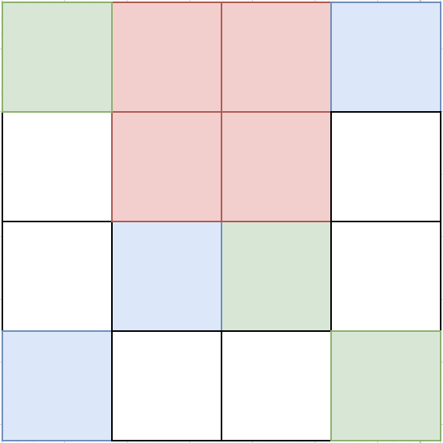
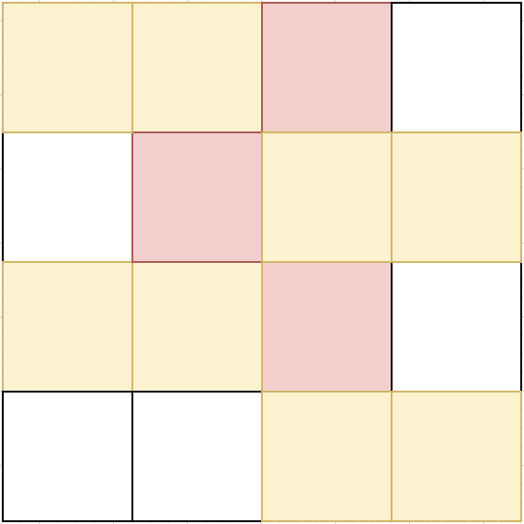
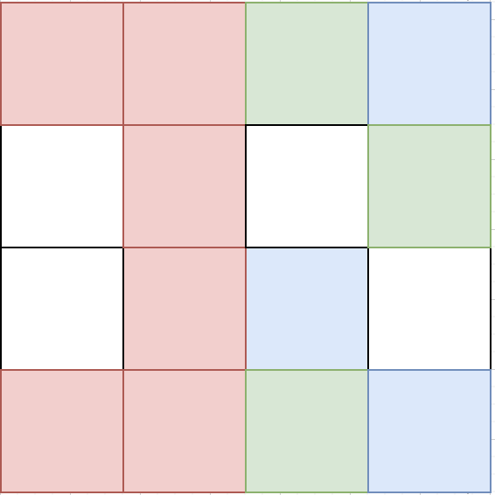
Initial state
Starting point
State from where the puzzle solving begins
Determines the problem and how hard the puzzle is
boards.py

Slide 8
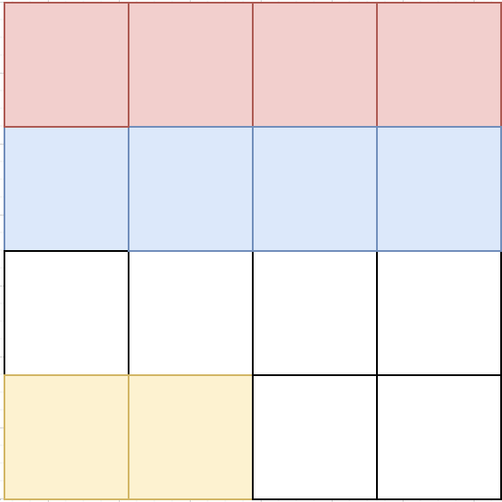
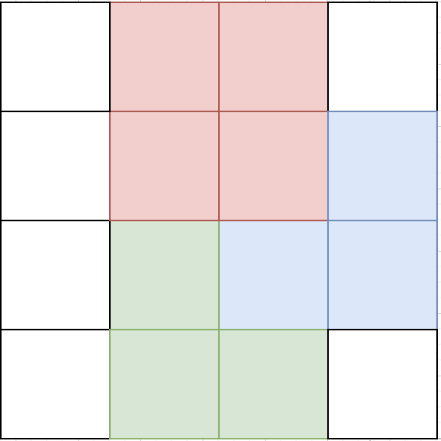
Objective test
How to verify if a puzzle is complete?
If there is only one piece of each colour = Puzzle complete
This is the final state of every puzzle of Cohesion
This test is made internally by checking if there is only one piece per colour with a non-empty list

Slide 9
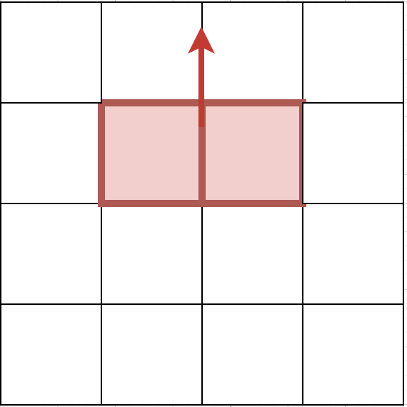
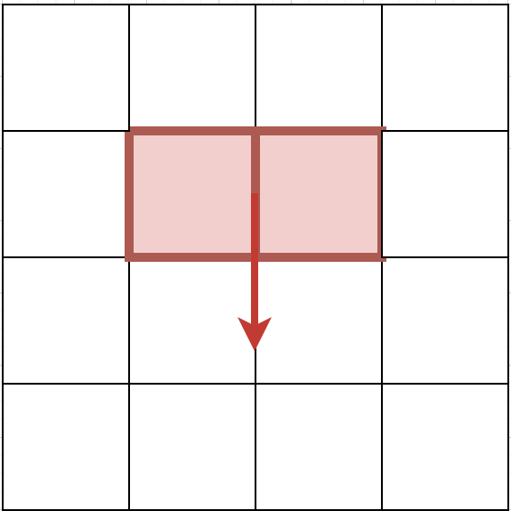
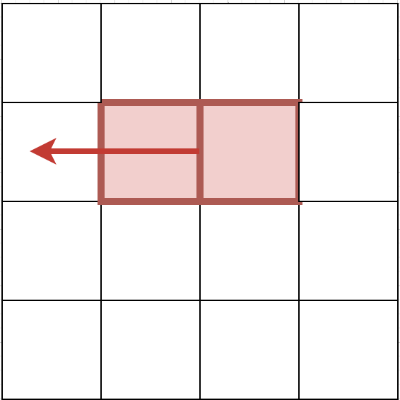
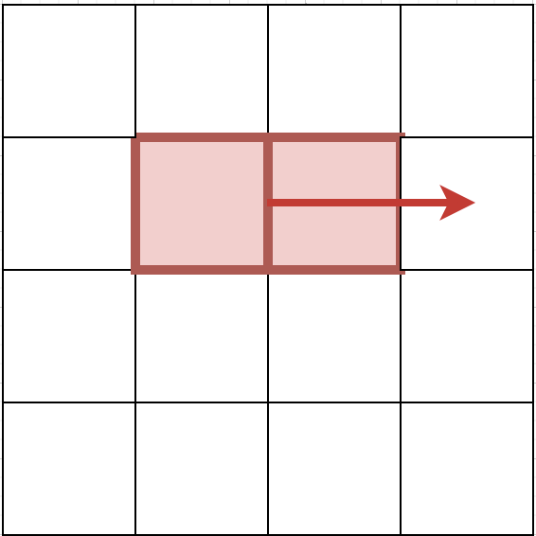
Operators
Possible actions
Move piece:
Up
Down
Left
Right
Can only move pieces to where they fit and have enough blank spaces
Internally, if a piece is moved, all the positions of that piece’s list of positions have to be updated, as well as the positions in the blank list

Slide 10
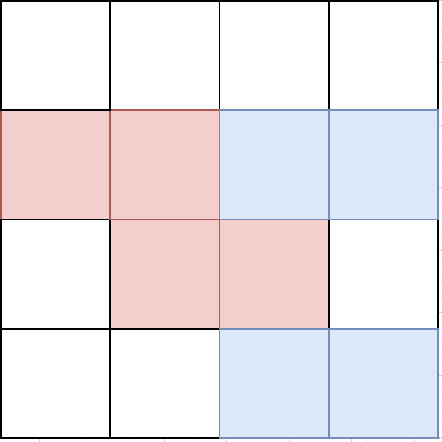
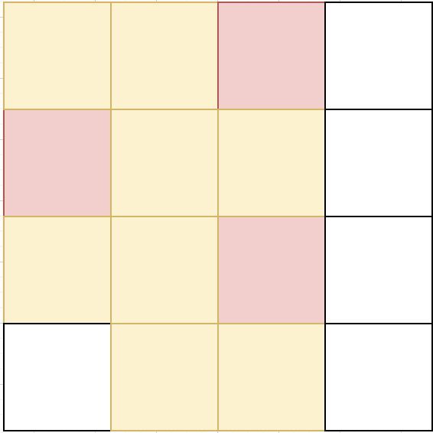
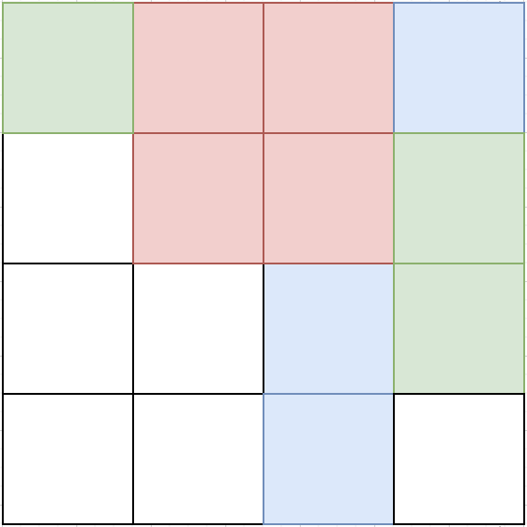
Puzzle solvability
Impossible states
Hard to tell the computer when a state is impossible, especially when there are a lot of pieces
Implemented a function that tries to solve this problem, but doesn’t work for every impossible state
Some states may look impossible but aren’t

Slide 11
Uninformed Search

Slide 12
Uninformed Search
Algorithms
Breadth-First Search (BFS)
Uniform-Cost Search (UCS) not implemented due to not having solution cost
Depth-First Search (DFS) implemented but not very functional due to getting stuck in infinity
Iterative Deepening Depth-First Search (IDDFS). This algorithm uses a DFS algorithm only up to a certain max_depth.

Slide 13
Breadth-First Search
Implementation
Uses a queue to store the children of each node it passes through.
Keeps track of visited states
Each iteration expands each node in the queue except if that node is unsolvable or is a state that has been visited
Stops if it found a solution to the puzzle or if it couldn’t find one

Slide 14
Iterative Deepening Depth-First Search
Implementation
Iteratively increases the depth of the search
Does DFS on every iteration by calling limited_depth_search with a max_depth
Iterative function stops if the solution was found or the depth limit has been reached without any solution

Slide 15
Informed Search

Slide 16
Informed Search
Algorithms
Heuristics
Greedy Search
A*
Weighted A*

Slide 17
Heuristics
Strategies used
Heuristic 1 : Determines the number of incorrect placed pieces on a board by comparing the positions of the pieces of that board with the ones from the solution board.
Heuristic 2 : Calculates the distance of all pieces on the current board to the final piece of their respective colour on the solution board.

Slide 18
Greedy Search
Implementation
The function implemented for this algorithm, takes the board and final board as inputs
Always expands the nodes with the lowest heuristic score
Stops expanding nodes when it has reached a solution

Slide 19
A* Search
Implementation
This algorithm uses the greedy search function for its implementation
Adds the amount of moves done to the score of the node which represents the distance from the root node
Gets more optimal solutions than Greedy Search

Slide 20
Weighted A* Search
Implementation
This algorithm is a variation of A*
Multiplies a weight (in the case of this project) of 3 to the amount of moves parameter
Gives a higher score to nodes with a higher amount of moves
Can sometimes make it harder to find the solution

Slide 21
Evaluation of results

Slide 22
Puzzle 1
 | # Moves | # Nodes explored | Time (s) | Memory (KB)
BFS | 4 | 12311 | 29.52 | 36712
IDDFS (50) | 4 | 4671 | 2.17 | 16772
Greedy H1 | 4 | 6 | 0.018 | 8167424
Greedy H2 | 4 | 5 | 0.015 | 8212480
A* H1 | 4 | 6 | 0.018 | 8110080
A* H2 | 4 | 5 | 0.014 | 8196096
Weighted A* H1 | 4 | 21 | 0.067 | 8343552
Weighted A* H2 | 4 | 19 | 0.062 | 8486912

Slide 23
Puzzle 2
 | # Moves | # Nodes explored | Time (s) | Memory (KB)
BFS | 8 | 11620 | 86.86 | 29928
IDDFS (50) | 9 | 98788 | 69.38 | 146036
Greedy H1 | 12 | 2191 | 5.28 | 13361152
Greedy H2 | 9 | 11 | 0.027 | 8138752
A* H1 | 10 | 126 | 0.28 | 9179136
A* H2 | 8 | 13 | 0.034 | 8126464
Weighted A* H1 | 8 | 6272 | 13.52 | 48984064
Weighted A* H2 | 8 | 1154 | 2.94 | 16347136

Slide 24
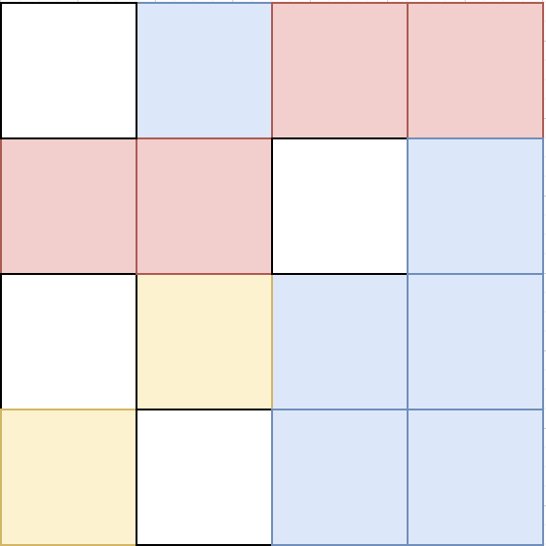
Puzzle 3
 | # Moves | # Nodes explored | Time (s) | Memory (KB)
BFS | 6 | 707 | 1.09 | 9412
IDDFS (50) | 6 | 3065 | 1.92 | 12460
Greedy H1 | 6 | 9 | 0.016 | 8171520
Greedy H2 | 6 | 7 | 0.014 | 8187904
A* H1 | 6 | 27 | 0.057 | 8151040
A* H2 | 6 | 28 | 0.058 | 8220672
Weighted A* H1 | 6 | 212 | 0.41 | 9347072
Weighted A* H2 | 6 | 305 | 0.66 | 9936896

Slide 25
Conclusion
Good results from what was expected
Room for improvement:
Better heuristics
Hint system
Etc.
Challenging and enriching project
Deepening of my knowledge about the development of AI to solve problems

